Slide 1


Slide 2
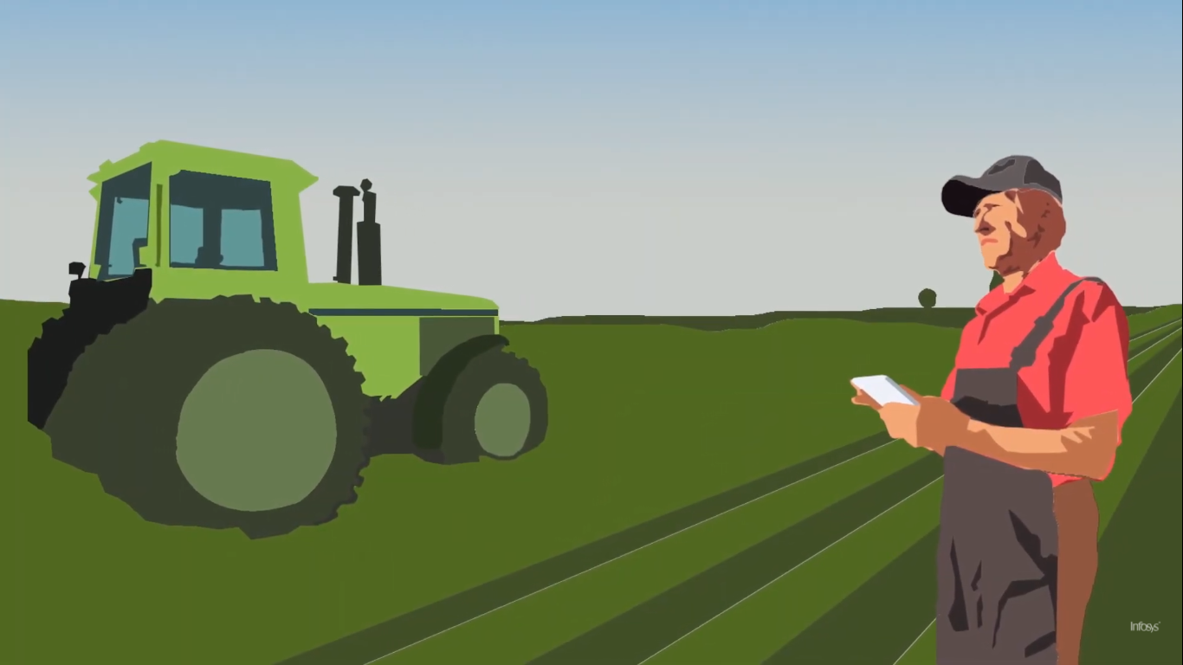
Introduction to Information and Communication Technology (CS-119)

Slide 3




Team
Zeeshan Ahmad
Zeeshan Mehmood
Abdul Basit
Sufyan Ahmad
201980008
201980051
2019980014
201980013

Slide 4
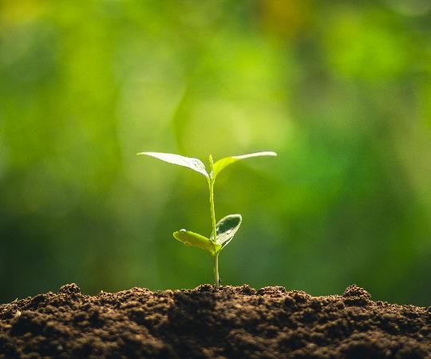
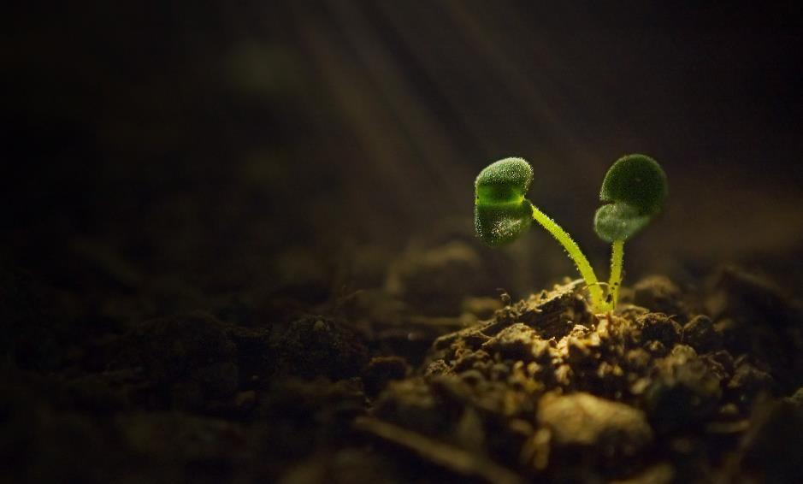
Agenda
WHAT IS AI
AI IN AGRICULTURE
USES
SCOPE

Slide 5
WHAT IS AI ?
Artificial intelligence (AI) is the ability of a computer or a robot. controlled by a computer to do tasks that are usually done by humans because they require human intelligence and discernment. Although there are no AIs that can perform the wide variety of tasks an ordinary human can do, some AIs can match humans in specific tasks

Slide 6
Artificial Intelligence
Advantages
More powerful and more advance computers.
Reduces in human efforts.
Better handling of information.
Faster and more accurate decisions.
Conversion of information into knowledge.
& Many more.

Slide 7
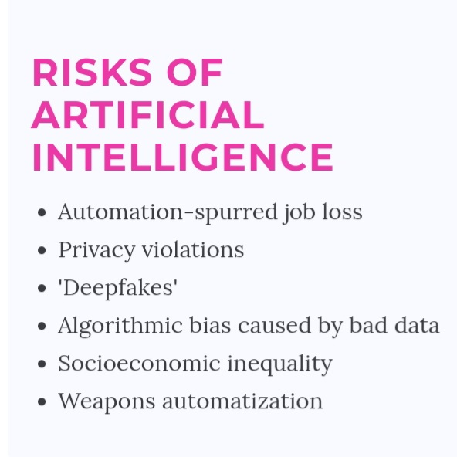
Artificial Intelligence
Disadvantages:
Difficulty with software development as it is slow.
Increased costs.
Few experienced programmers.
Few practical products have reached market.
Death of talent.
& Many more.

Slide 8
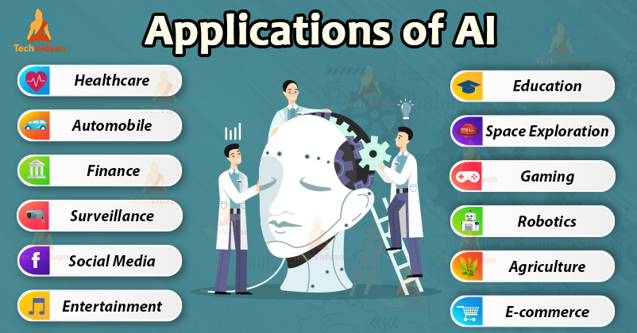
Artificial Intelligence

Slide 9
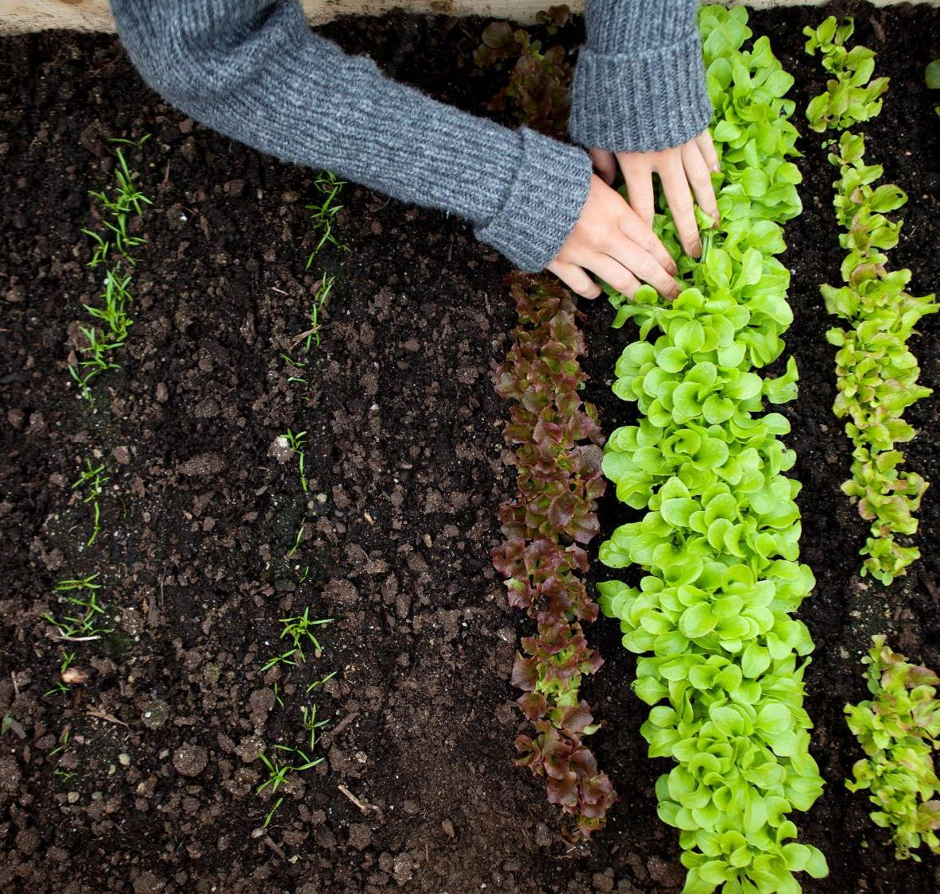
Artificial Intelligence IN AGRICULTURE

Slide 10

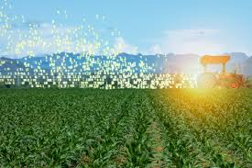
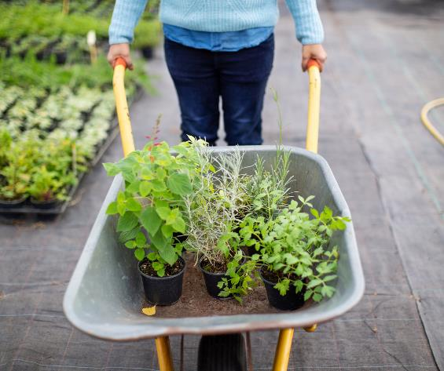
Introduction
Farming are one of the oldest and most important professions in the world. It plays an important role in the economic sector. Worldwide, agriculture is a $5 trillion industry. First of all The agriculture sector is the foundation of World's economy and with the increasing population, the World will need to produce 50% more by 2050.

Slide 11
Introduction
World's most vital sector THE AGRICULTURE. Industry is turning Artificial Intelligence technologies to yield healthier crops, control pests, monitor soil, and growing conditions, organize data for farmers, help with the workload, and improve a wide range of agriculture-related tasks in the entire food supply chain.

Slide 12
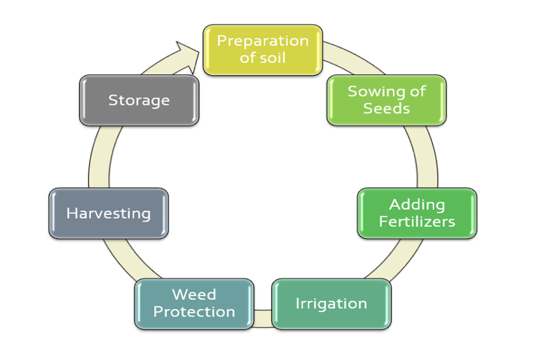
The Life Cycle of Agriculture

Slide 13
Applications of Artificial Intelligence in Agriculture:
Use of weather forecasting: With the change in climatic condition and increasing pollution it’s difficult for farmers to determine the right time for sowing seed, with help of Artificial Intelligence farmers can analyze weather conditions by using weather forecasting which helps they plan the type of crop can be grown and when should seeds be sown.

Slide 14
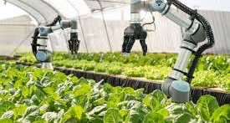
Applications of Artificial
Intelligence in Agriculture:
Agricultural Robots: The robots are performing various agricultural operations autonomously such as weeding, irrigation, guarding the farms for delivering effective reports, ensuring that the adverse environmental conditions do not affect the production, increase precision, and manage individual plants in various unfamiliar ways.

Slide 15
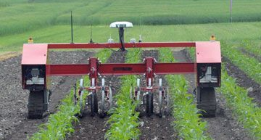
Applications of Artificial
Intelligence in Agriculture:
Weeding By Robots: The vision based technologies which were used to guide the robots along the row structure to remove weeds and to differentiate the single crop among the weed plants. The various weeding systems are Precision Weed Manage, Autonomous Weeding Robot, Weeds Detection in Agricultural Fields And Much More.

Slide 16
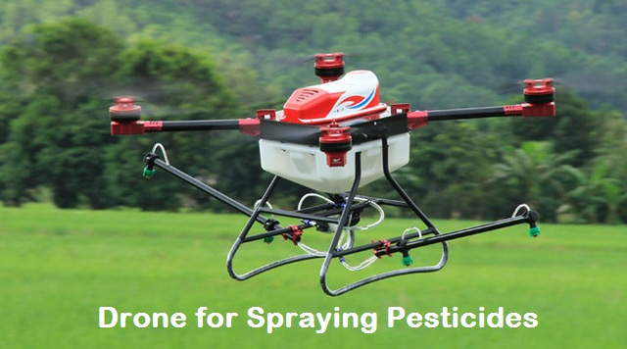
Applications of Artificial
Intelligence in Agriculture:
Drones in agriculture: Unmanned aeronautical vehicles (UAVs) called automatons, in a mechanical setting are unmanned aircrafts that can be remotely controlled. They work in confluence with the GPS and others sensors mounted on them. Drones are being implemented in agriculture for crop health monitoring, irrigation equipment monitoring, weed identification, herd and wildlife monitoring, and disaster management.

Slide 17
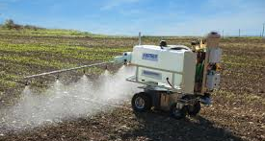
Applications of Artificial
Intelligence in Agriculture:
Crop spraying: Drones have been utilized as substance sprayers by farmers since numerous years now and they are considered as effective in the situations of cloudy climate and has also solved the problem of in accessibility to a field of tall crops, for example, maize. Additionally, they are likewise accepted to have a solid favorable position contrasted with satellite airborne sensors of high picture resolution retrofitted an air-carrier plantation sprayer with a microcomputer based sprayer control framework.

Slide 18
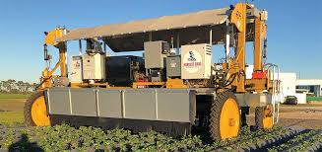
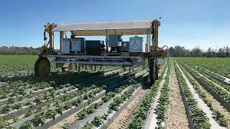
Harvest CROO Robotics:
In 2017, Florida based-wish Farms announced its implementation of it.

Slide 19
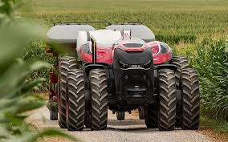
AI Driver-less Tractor:
Case IH and New Holland both introduced their new autonomous tractors at 2016 farm Progressive Show.

Slide 20
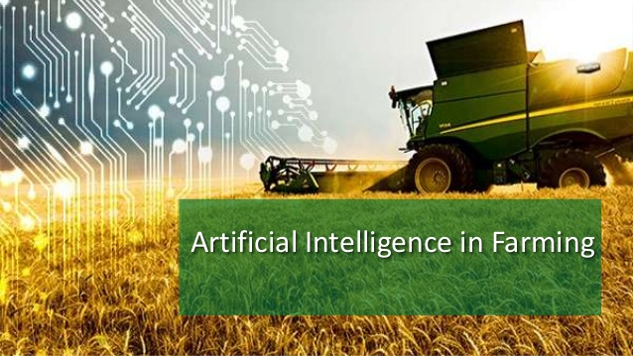
Benefits of AI in Agriculture:
AI- based technological solutions has enabled the farmers to produce more output with less input and even improved the quality of output, also ensuring faster go-to- market for the yielded crops. By 2020, farmers will be using 75 million connected devices. By 2050, the average farm is expected to generate an average of 4.1 million data points every day.

Slide 21
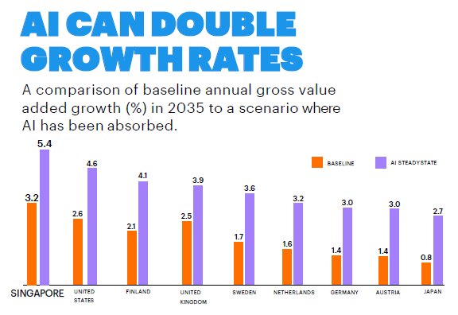


Slide 22
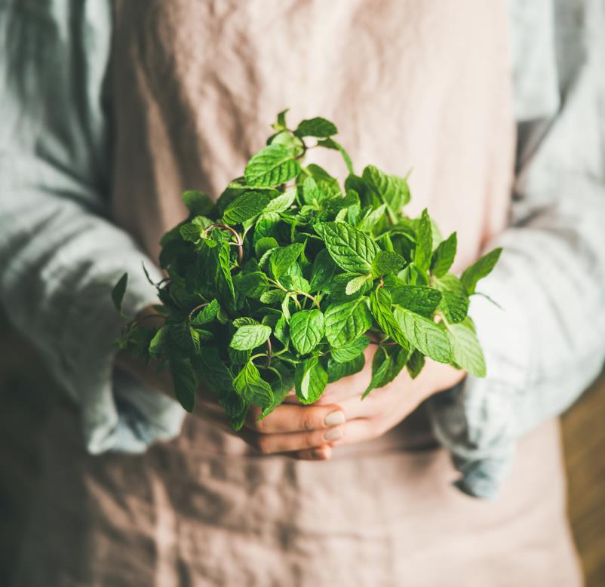
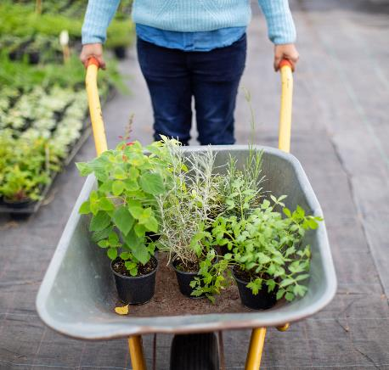
Summary
To encounter the problems facing the farmers hope that AI SERVICES & SOLUTIONS should make their mark to uplift the position of FARMERS.

Slide 23
Some References:
https://www.sciencedirect.com/science/article/pii/S258972172030012X
https://www.google.com/amp/s/searchenterpriseai.techtarget.com/feature/Agricultural-AI-yields-better-crops-through-data-analytics%3famp=1

Slide 24

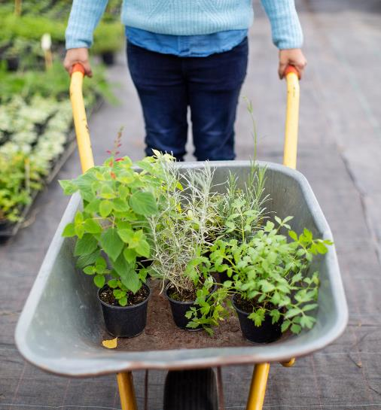
Thank You

